Slide 1
MTL for Cross Asset Price Prediction
Mentee: Gabrielle Wu, Violet Song, Xinyi Nie
Mentor: Hao Quan
Notes:
Hi everyone. Today we are going to talk about our project focuses on 'Multitask Learning for Across-Asset Price Prediction.'
Under the mentorship of Hao Quan, we started from The Fundamentals of Machine Learning, then gradually explored how MTL can be used to predict financial markets.

Slide 2
Outline
#1
#2
#3
#4
Project Motivation
Method
Data Processing
Result & Conclusion

Slide 3
Project Motivation
The Reality: Asset prices (stocks, commodities) are interconnected, not isolated.
The Problem: Traditional single-task forecasting treats each asset independently.
Our Goal: Utilize Multitask Learning (MTL) to share information across assets.
Objective: Improve prediction efficiency and accuracy compared to single-task models.
Notes:
So, why did we choose this topic? If you look at the financial world, asset prices don't move in a vacuum. Stocks, commodities like Gold, and currencies are heavily interconnected. However, traditional forecasting methods often treat every asset as an isolated time series. Our motivation was to move away from that isolation. We wanted to use Multitask Learning to let our model 'share' information across different assets. The hypothesis is that by learning the shared features of the market, we can improve both the efficiency and the accuracy of our predictions compared to looking at one stock at a time.

Slide 4
Methodology
Methodology
Baseline Models:
Linear Regression
FNN
Multitask Learning Model
Shared representation layer learns cross-asset features
Task-specific output heads predict each asset price separately

Slide 5
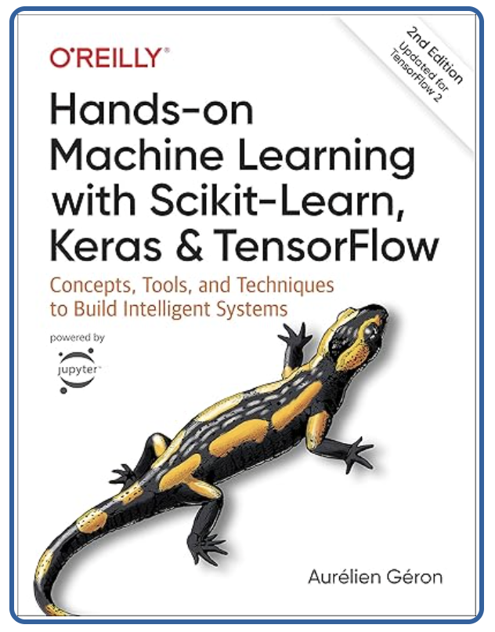
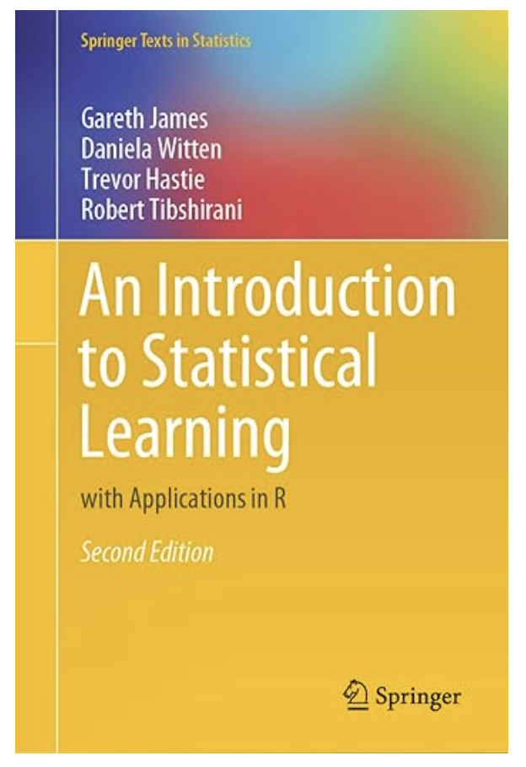
Reading Material
1. Hands-on Machine Learning with Scikit-Learn, Keras, and TensorFlow (Ch. 1–2) (Géron, 2022)
The ML Landscape: Supervised vs. Unsupervised, Batch vs. Online.
End-to-End Pipeline: Data splitting, cleaning, feature engineering, and cross-validation.
2. An Introduction to Statistical Learning : With applications in Python (Ch. 10) (James, 2023)
Statistical rigor behind Linear/Logistic Regression & Clustering.
Deep Learning (Ch. 10): Perceptrons, Multilayer Perceptrons (MLP), Backpropagation, and Hyperparameter tuning (Layers, Neurons, Learning Rates).
Notes:
To build a strong foundation for this project, we began with two fundamental texts.
First, we read the opening chapters of Hands-On Machine Learning by Géron. This gave us the 'big picture'—understanding the end-to-end machine learning workflow. We learned how to properly split data to avoid data leakage, how to engineer features, and the critical importance of validating our models to prevent overfitting.
Then, we dived into the math using An Introduction to Statistical Learning. While we started with the statistical basics of regression and clustering, our main focus was Chapter 10. This section bridged the gap between traditional statistics and modern AI, teaching us the mathematical structure of Neural Networks—specifically how Perceptrons and Multilayer Perceptrons learn through backpropagation. This theoretical grounding was essential before we started writing any deep learning code."

Slide 6
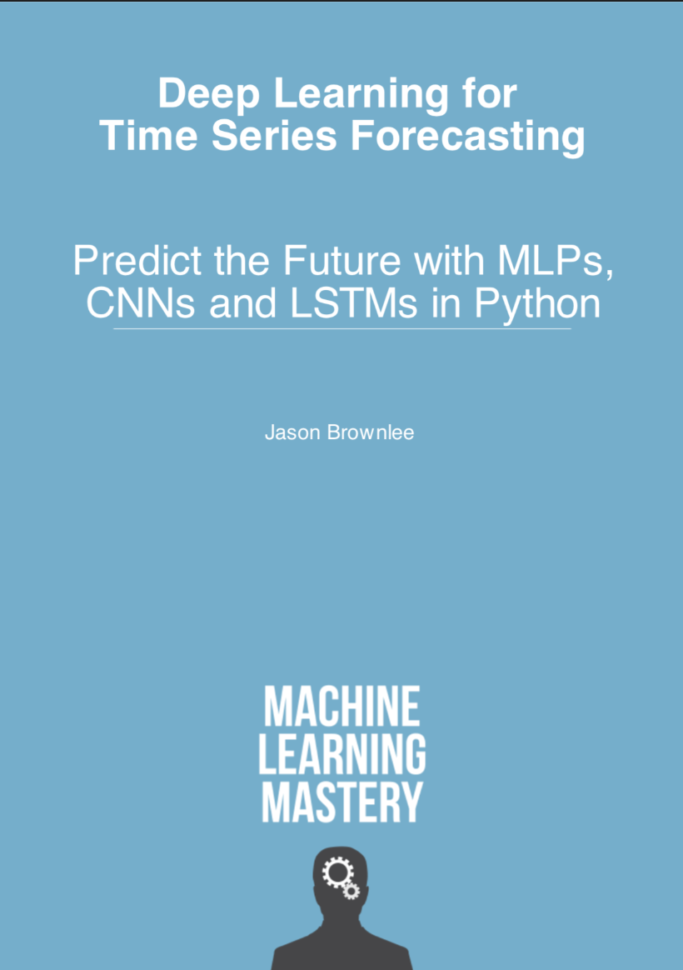

Reading Material
3. Deep Learning for Time Series Forecasting (Ch. 1–5)
(Brownlee, 2018)
Framing time series as a supervised learning problem (Sliding Windows).
Handling temporal dependence and stationarity.
4. Multitask Learning Machine Learning (Caruana, 1997)
Inductive Transfer: Improving generalization by learning tasks in parallel.
Shared Representation: How related tasks (different assets) share hidden layer features to reduce noise.
Notes:
Once we had the general ML foundation, we specialized in the specific techniques needed for our project.
We used Jason Brownlee’s guide on Time Series Forecasting to learn how to transform our financial data into a format a neural network could understand. We learned to use 'sliding windows' to frame time series forecasting as a supervised learning problem—using past data to predict future prices.
Finally, we studied the core theory behind our project: Rich Caruana’s seminal paper on Multitask Learning. This reading was crucial for understanding why our project should work. We learned that by training a model on multiple related tasks—like predicting Gold and Apple stocks simultaneously—the model can use a 'shared representation' to learn general market trends. This 'inductive transfer' helps the model distinguish true signals from noise better than if it were learning each asset in isolation."

Slide 7
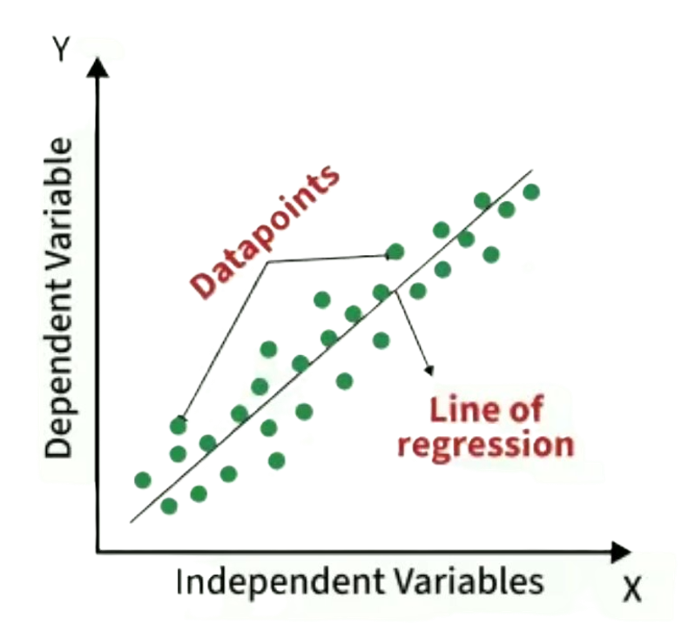

Baseline Model 1 – Linear Regression
Linear regression models the relationship between independent variables X and a continuous dependent variable Y.
Find the best fitting line by minimizing prediction errors using Least squares method
It calculates coefficients for variables that minimize the error in prediction.
Notes:
Our first baseline was Linear Regression. We chose this because it is the standard starting point for any predictive task. It attempts to predict the future price as a weighted sum of past prices.
Pros: It is incredibly fast to train and mathematically easy to interpret.
Cons: However, financial markets are rarely linear. As we expected, this model struggled to capture sudden market shifts, serving mostly as a benchmark to see how much better our Deep Learning models could perform."

Slide 8
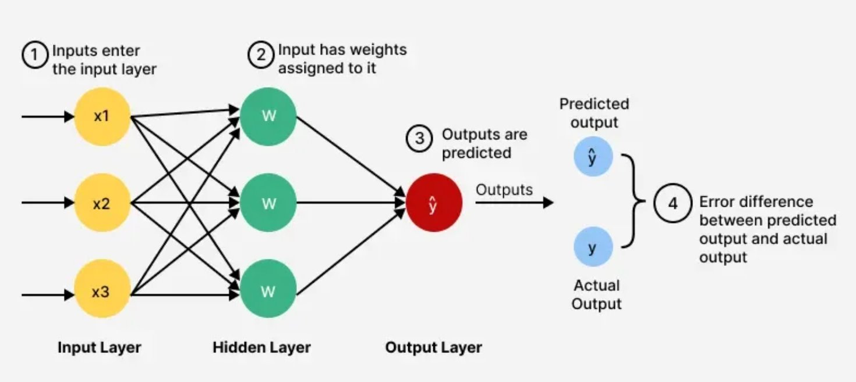
Baseline Model 2 – Feedforward Neural Network (FNN)
A neural network where data flows one way i.e. from input to output.
No loops or feedback.
Used for tasks like pattern recognition (e.g. image and speech).
FNN is used here for simplicity
Notes:
To address the limitations of the linear model, we moved to our second baseline: the Feedforward Neural Network (FNN).
While Linear Regression assumes a straight-line relationship, the FNN allows us to step into the world of Deep Learning.
Structure: As you can see in the diagram, information flows in one direction—from the input layer (our historical prices), through 'hidden layers', to the output.
Why it helps: The key here is these hidden layers. By stacking them, the network can learn non-linear patterns and complex features that a simple regression model would miss.
Configuration: For our project, we tuned specific hyperparameters. Which gave us a balance between capturing market volatility and keeping the model efficient to train." So, we have established our baselines: Linear Regression (simple but limited) and FNN (powerful but treated as a single task). Now, Wu will explain how we took this FNN architecture and evolved it into a Multitask Learning model to predict multiple assets simultaneously."

Slide 9
Multitask Learning Model
Defination
One model learning several related tasks at the same time.
Shared Learning
Tasks that are related often need similar skills
MTL creates a shared representation that all tasks benefit from
Each task also has its own output layer
Notes:
“Multitask Learning simply means training one model to do several tasks at the same time. Think of it like a student who learns math and physics together — understanding one often helps with the other. MTL works in a similar way.”
“The key idea is shared learning. The early layers of the model learn patterns that are useful for all tasks, like general shapes in images or general grammar in text. Then each task has its own output layer for what makes it unique. This structure helps the model learn both what’s common and what’s different.”

Slide 10
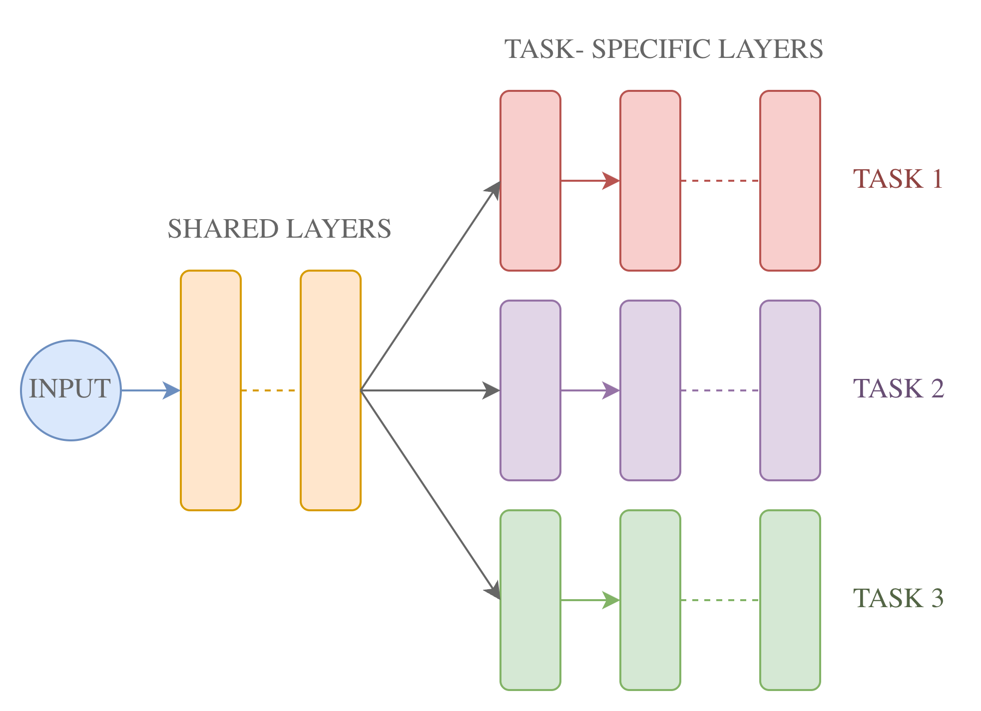
How Multitask Learning Model Works?
Input enters the model
Shared layers learn patterns useful for all tasks
Task-specific layers learn what makes each task unique
The model updates itself using all tasks at once
Notes:
“Here’s the flow:
The data goes into the model.
Shared layers learn the general patterns — the foundational knowledge.
Task-specific layers learn details that belong to each task.
The model updates itself using all tasks, so each task reinforces the others. This joint learning builds a stronger model.”

Slide 11
Multitask Learning Model
Benifits
Better Performance
Requires Less Data
Faster and Cheaper
More Robust Predictions
When to use MTL
When not to use MTL
Tasks are related
Share common features
Can benefit from one another
Tasks are unrelated
One task dominates the others
Your tasks have conflicting goals
Notes:
“Here are the main advantages:
Better performance: the shared knowledge improves accuracy.
Less data needed: because tasks help each other learn.
More efficiency: you train one model instead of several.
More robustness: the model generalizes better because it sees the problem from multiple angles.”
“MTL is powerful, but we need the tasks to be related. For example, predicting a customer’s purchase and browsing patterns — all of these are connected. If tasks share underlying patterns, they will benefit from being learned together.”
“We should not use MTL when the tasks are unrelated — for example, combining stock prediction would confuse the model. Also, if one task is much harder or has much more data, it might dominate the learning and harm the smaller tasks. And if the tasks have conflicting goals, MTL can become counterproductive.”

Slide 12
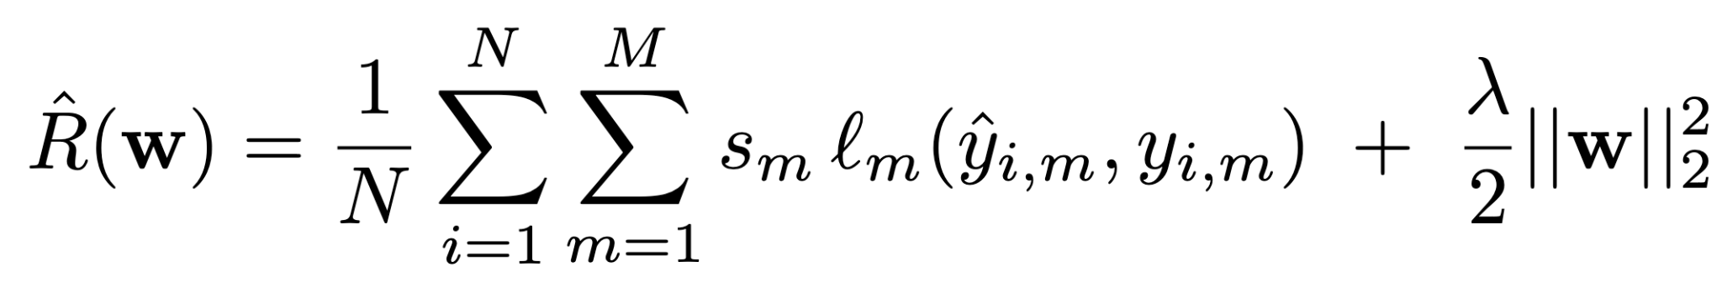
Multitask Learning Model – Global Empirical Risk
Regularization
reduce overfitting
keep the shared layers smooth
ensure the model generalizes better
Total Weighted Loss
over all data points
over all tasks
Each task m has its own loss function l_{m}
Each task has a weight s_{m}
In our MTL model, tasks are equally weighted
Notes:
This is the Global Empirical Risk function, it measures the total error of the Multi-Task Learning model. The first part of the equation is the total weighted loss. This is where we add up the errors across two dimensions: all data points from 1 to N, all tasks from 1 to M. Each task has its own loss function, for example, squared error, and each task also has a weight s_{m}. These weights control how important each task is during training. In our model, for simplicity, all tasks are equally weighted, so no task dominates the learning.
The second part of the equation is the regularization term. This doesn’t come from the data — it’s added to stabilize the training. It reduces overfitting, keeps the shared layers smooth, helps the model generalize better.

Slide 13
Data Collection
Historical data obtained from yfinance.
We request the adjusted closing prices for three tickers:
GLD – Gold ETF
^GSPC – S&P 500 Index
AAPL – Apple Inc. stock
Cleaning steps:
1 Align timestamps
2 Handle missing values
3 Train: 70%, Val: 15%, Test: 15%

Slide 14
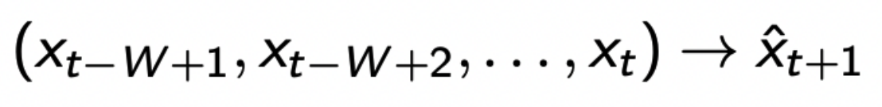
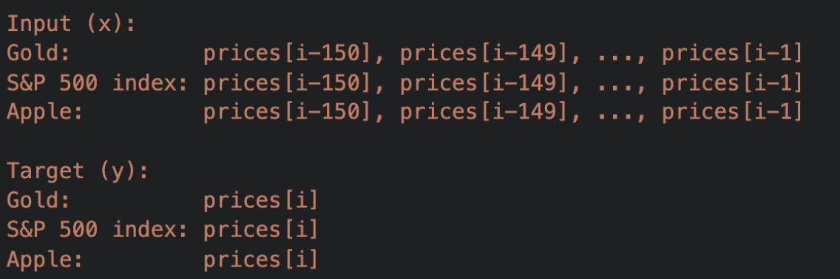
Sliding Window Method
Time series prediction requires choosing how many past observations
to include.
Let W denote the window size (150).
For each day in the loop of range(WINDOW, N) we collect training sample:

Slide 15
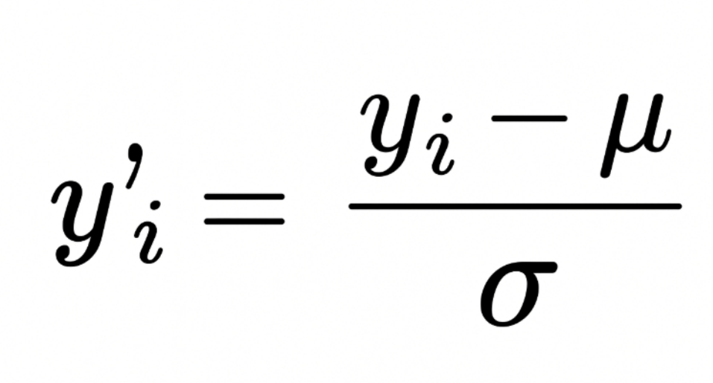
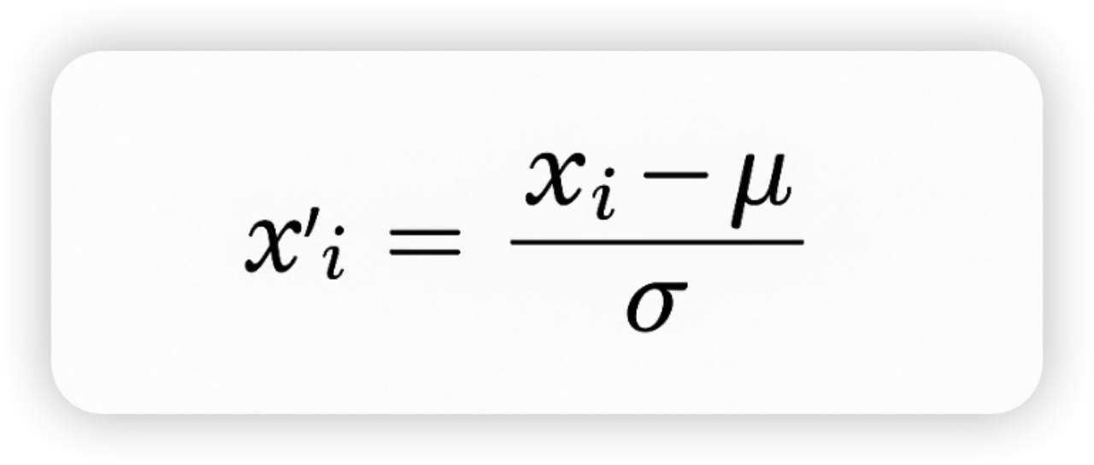
Feature Construction
Feature Construction: turning raw market data into a form that the neural network can effectively learn from.
Create two StandardScaler objects:
One for the input features x One for target prices(next-day prices) y
Feature becomes consistent and standardized.
Mean = 0 and Standard Deviation = 1

Slide 16
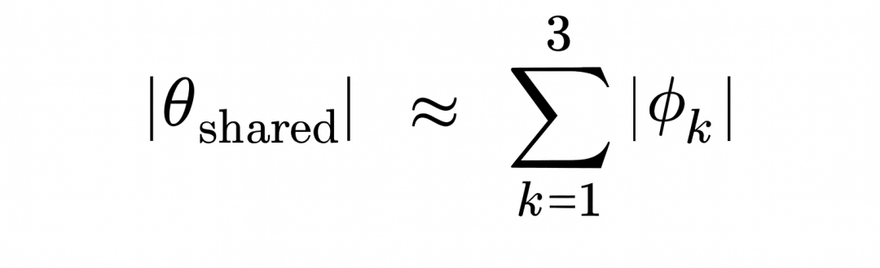
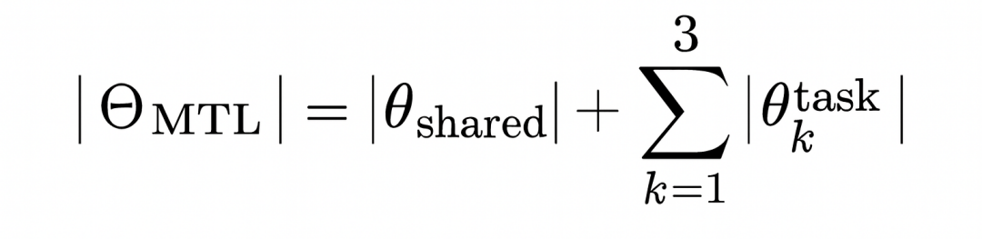
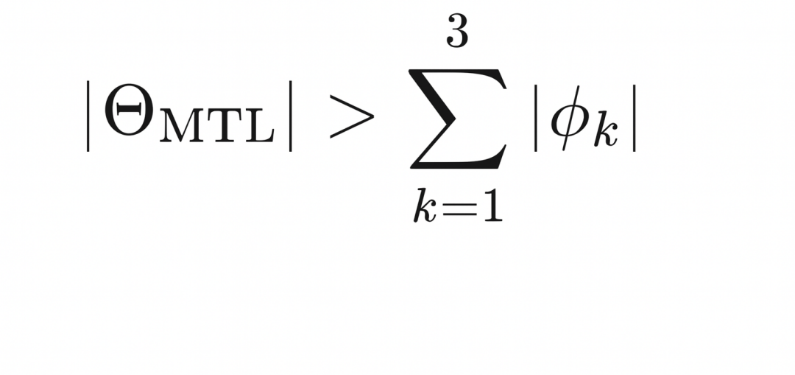
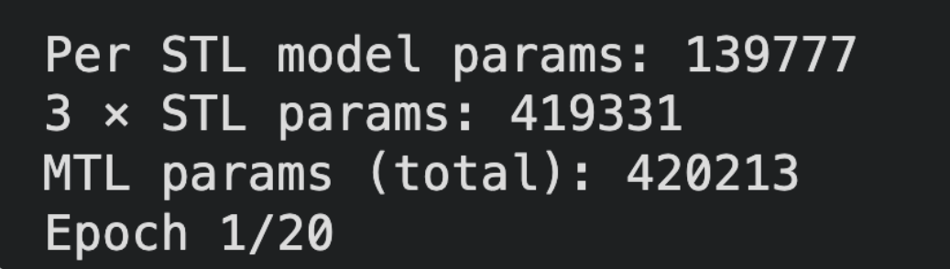
Architecture Design and Capacity Matching
MTL uses a shared backbone with capacity ≈ sum of 3 STLs’ total parameters
Additional task-specific heads add small extra hyperparameters.

Slide 17
Hyperparameter Tuning
Hyperparameter Tuning: trying different combinations of model settings to find the one that gives the best validation performance.
Hyperparameter we tuned:
➤ Learning rate ➤ Number of Hidden Layers
➤ Batch Size ➤ Number of Hidden Units
➤ Dropout ➤ Activation Function

Slide 18
FNN vs Linear Regression
FNN
 | MAE | RMSE | MSE | Final Training Runtime (seconds)
APPL | 11.10 | 13.08 | 171.00 | 3.43
SPY | 19.95 | 24.36 | 593.37 | 1.98
GOLD | 22.30 | 26.42 | 698.14 | 2.13
Linear Regression
 | MAE | RMSE | MSE | Runtime (seconds)
APPL | 5.21 | 7.27 | 52.90 | 0.0071
SPY | 7.35 | 10.51 | 110.41 | 0.0074
GOLD | 5.27 | 6.76 | 45.65 | 0.0097
Notes:
MSE Average squared error. More sensitive to occasional large mistakes.
RMSE Root of MSE (same units as the target). Since your target is daily returns (%), RMSE is also in percentage points.
MAE Average absolute error. Intuitive measure of “typical prediction error.”
Now, let’s look at the results of our experiments. We evaluated our models using three key metrics: MSE, RMSE, and MAE to measure accuracy, and we also recorded the runtime to measure efficiency.
Hao:
LR outperforms FNN in accuacy and efficiency
Why LR outperforms FNN
dataset is simple or in low dimension
only past returns are used (we do not include any technical indicator or even in practice we can use the news from different social platform)
FNN may overfits (observed that the accuacy of validation and testing dataset are very different)
FNN is not ideal for time series data
Takeaway

Slide 19
Performance Comparison (FNN V.S. MTL)
FNN
 | MAE | RMSE | MSE | Final Training Runtime (seconds)
APPL | 11.10 | 13.08 | 171.00 | 3.43
SPY | 19.95 | 24.36 | 593.37 | 1.98
GOLD | 22.30 | 26.42 | 698.14 | 2.13
Combined | 53.36 | 63.86 | 1462.51 | 7.54
MTL
 | MAE | RMSE | MSE | Final Training Runtime (seconds)
APPL | 7.51 | 9.08 | 82.39 | NA
SPY | 10.65 | 13.79 | 190.11
GOLD | 4.86 | 6.26 | 39.24
Combined | 7.68 | 10.19 | 103.91 | 1.07
Notes:
Then, even though the LR regression performs really well in this task, we still need to compare the performance of our single-task FNN models with the multitask learning model. Since we aim to verify in a very initial stage that MTL can increase the performance.
Starting with the FNNs: each task is trained independently, and errors are relatively high—APPL at 11.10, SPY at 19.95, and GOLD at 22.30—giving a combined MAE of 53.36. Training all three models takes about 7.5 seconds.
In contrast, the multitask model trains all tasks jointly and improves performance across the board. APPL drops to 7.51, SPY to 10.65, and GOLD to 4.86. The combined MAE is just 7.68, far lower than the separate FNNs.
This represents a dramatic reduction in prediction error—roughly an order of magnitude improvement in the aggregated metrics.
Finally, the training runtime also highlights one of the practical advantages of multitask learning. Instead of training three independent models, we train a single network, and the total runtime is just over one second. So MTL not only improves accuracy but is also significantly more computationally efficient.
Overall, these results demonstrate strong positive transfer across tasks and show that multitask learning extracts shared structure that the individual FNNs are unable to capture.

Slide 20
Conclusion
1. Linear Regression performs best
▪Captures most of the predictable structure
▪Neural networks add unnecessary complexity → higher variance
▪For next-day prediction, the signal is largely linear
2. MTL > Three STL models combined
▪Assets share latent market structure
▪Shared trunk improves generalization
▪Same total model capacity but better performance
3. Interpretation
▪FNN underperformance ≠ MTL failure
▪The prediction task is dominated by linear patterns
▪But MTL still proves the benefit of learning tasks jointly
Notes:
Let me summarize the key findings from our experiments.
First, the most striking result is that linear regression significantly outperforms both the single-task and the multi-task neural networks.
Even though neural networks are more flexible and capable of modeling nonlinear relationships, in our setting—predicting next-day returns using a 150-day rolling window—the underlying signal appears to be mostly linear.
The additional nonlinearity in FNNs does not help; instead, it increases variance and leads to worse generalization.
Second, when we compare the neural network models internally, we consistently find that the MTL model performs substantially better than the three STL models combined in both runtime and accuracy metrics, even though the total parameter capacity is comparable.
This indicates that GLD, S&P 500, and AAPL share meaningful underlying market structure.
By learning a shared representation, MTL reduces overfitting and improves sample efficiency relative to training three independent models.
Third, combining these observations gives us a more complete picture of the modeling landscape:
Neural networks do not outperform linear regression here not because the MTL framework is flawed, but because the prediction problem itself is predominantly linear.
However, MTL clearly outperforms STL, confirming that cross-asset learning is beneficial when using more flexible models.
So, our overall takeaway is:
Linear models remain extremely strong baselines for short-horizon financial prediction.
But if neural networks are used, MTL is decisively superior to STL because it leverages shared structure across assets.

Slide 21
Future Improvements
▪Expand Model Classes.
▪Feature Engineering and Market Microstructure.
▪Improving MTL via Dynamic Task Weighting
Notes:
Finally, I want to briefly highlight several directions for future improvement.
First, we can expand our model classes. So far, we’ve focused mainly on feedforward networks, but financial time series often require richer temporal modeling. Incorporating architectures such as LSTMs, TCNs, or transformers could help capture sequential patterns that simple FNNs may miss.
Second, feature engineering and market microstructure features can substantially improve predictive power. Currently, the model only uses past returns. Adding volatility measures, realized correlations, macroeconomic signals, or liquidity indicators could provide more structure and help the model generalize better.
And third, an important extension is improving our multitask learning framework through dynamic task weighting. Right now every task is weighted equally, but tasks differ in difficulty, as we can see from the previous experiment the prediction accuracy for Apple stock and Gold is lower than the accuracy for SP500 index, which means that underperforming tasks should be given higher weights so the shared trunk allocates more capacity to them. Methods such as inverse-loss weighting, uncertainty weighting, or gradient balancing can help us achieve this.
Overall, these improvements can make the model more expressive, more robust, and more aligned with the true structure of financial markets.

Slide 22
Thank you for listening
Q & A

